Slide 1
Alpha_W

Slide 2
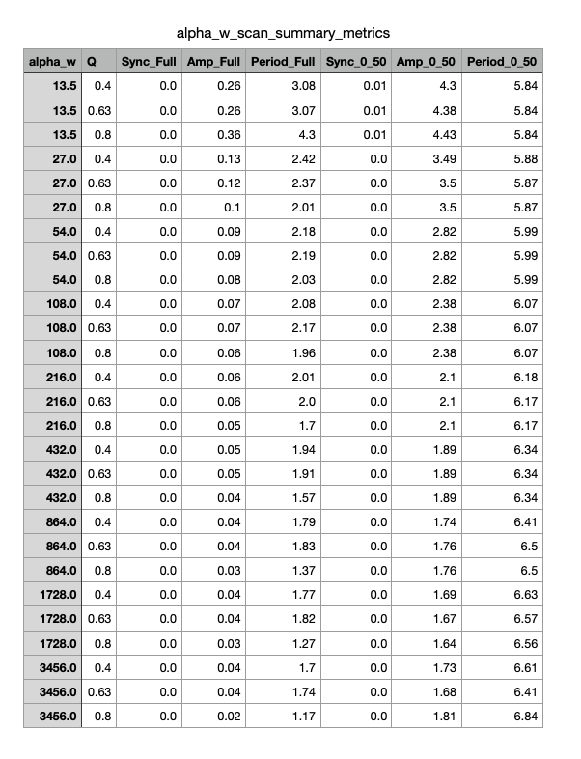
Summary Table From Alpha_W Parameter Scan

Slide 3
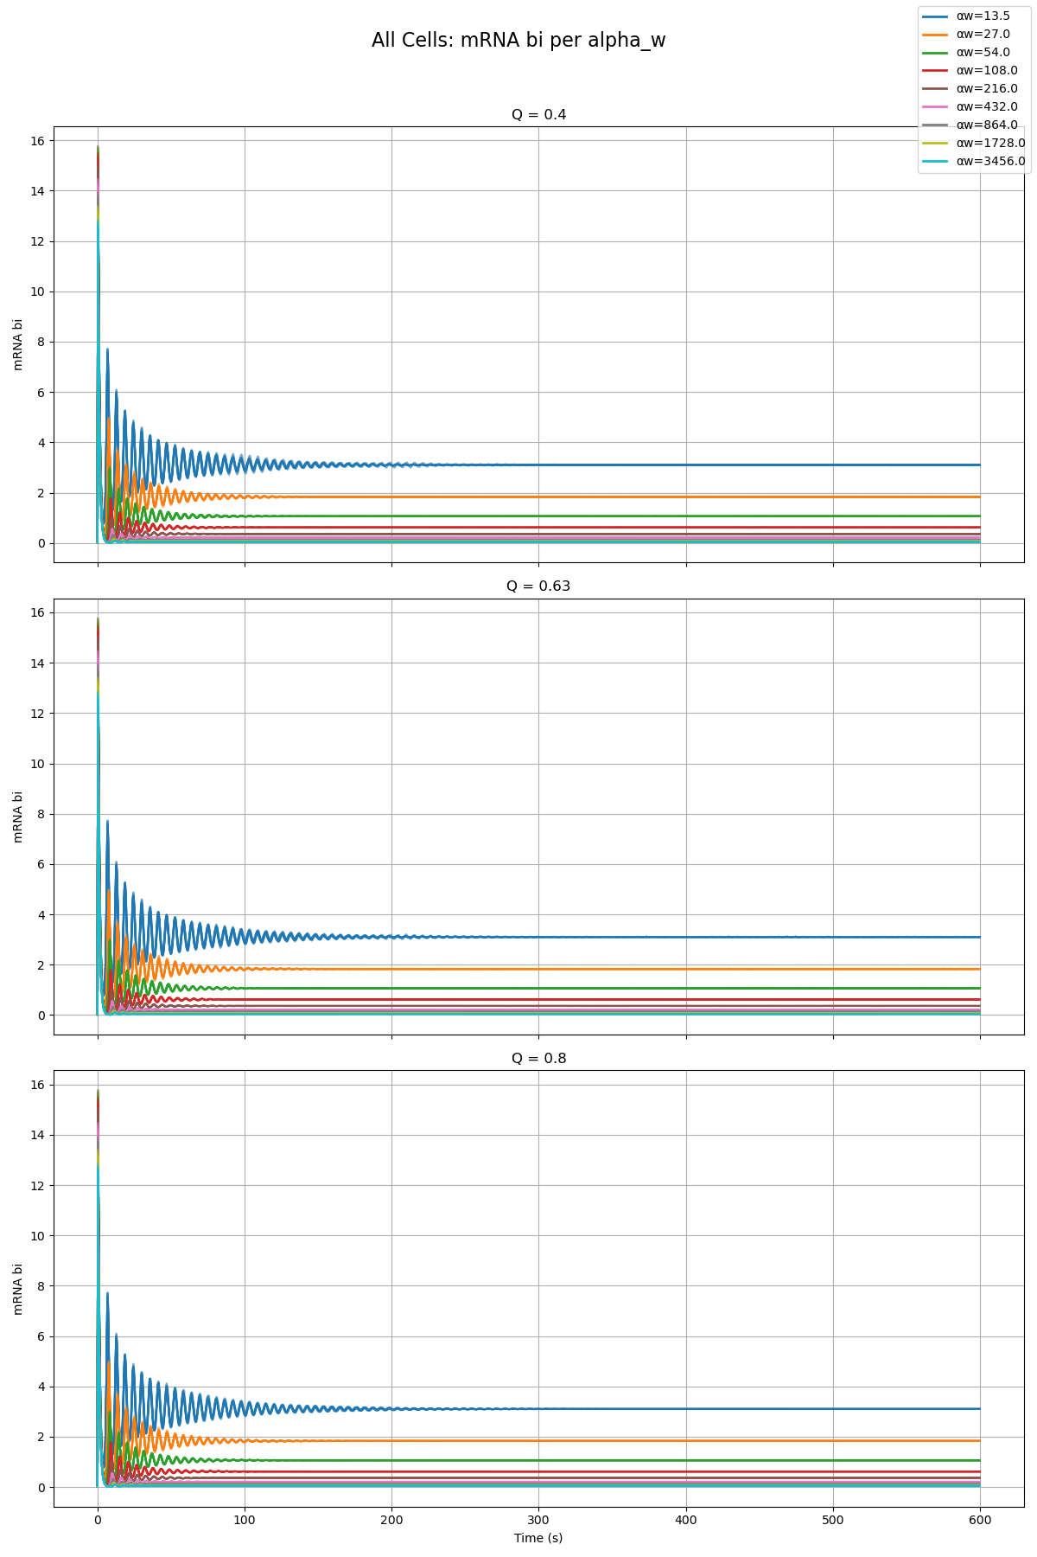
Combined Plot of All Cells and All Qs From Alpha_W Parameter Scan

Slide 4
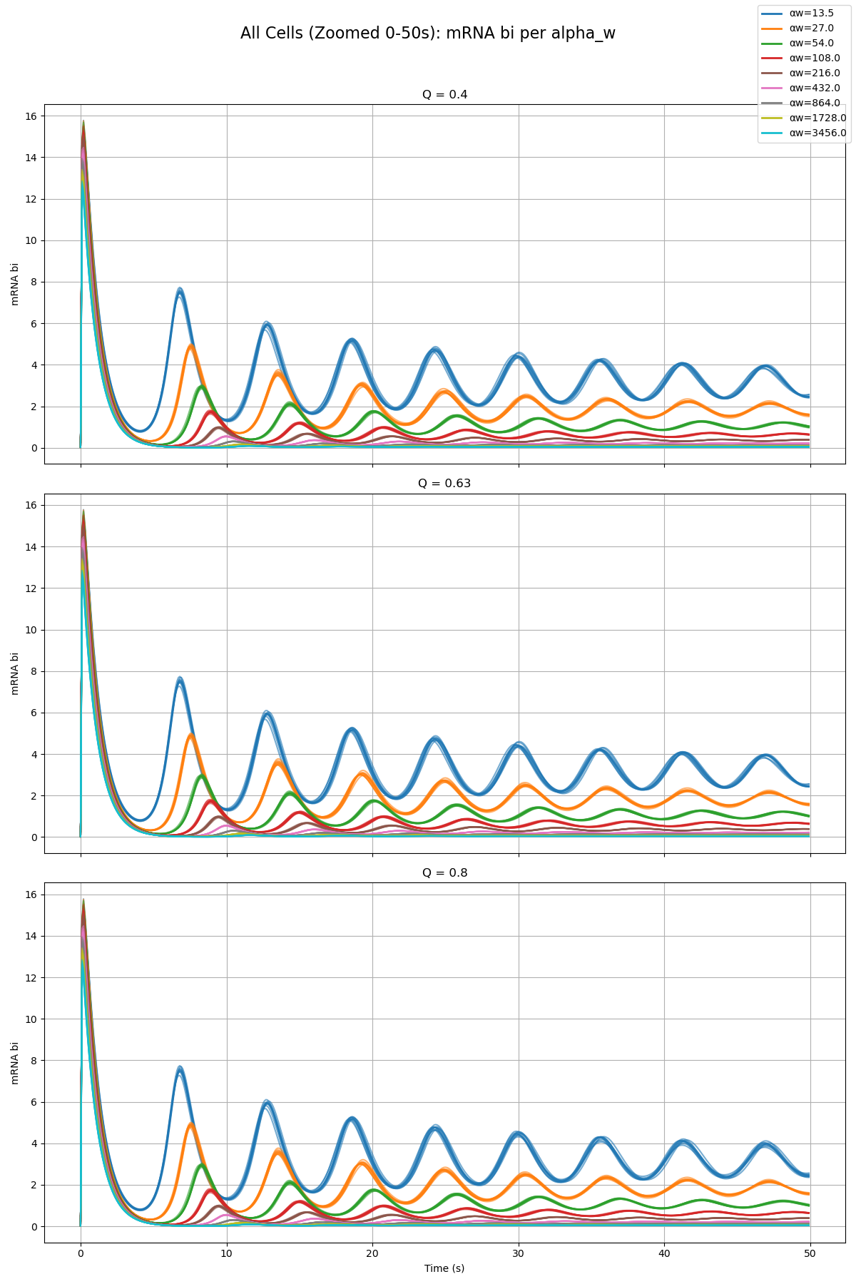
Combined Plot of All Cells and All Qs From Alpha_W Parameter Scan

Slide 5
Alpha_X

Slide 6
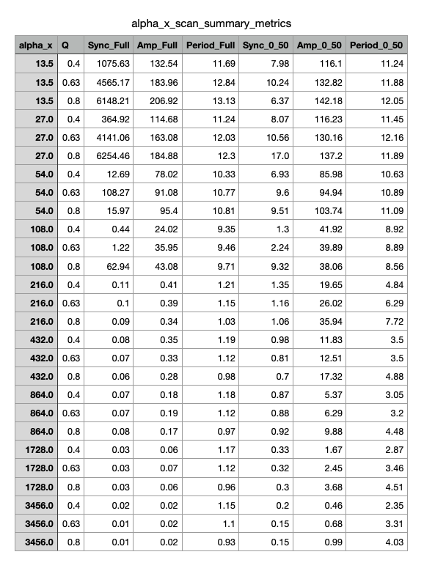
Summary Table From Alpha_X Parameter Scan

Slide 7
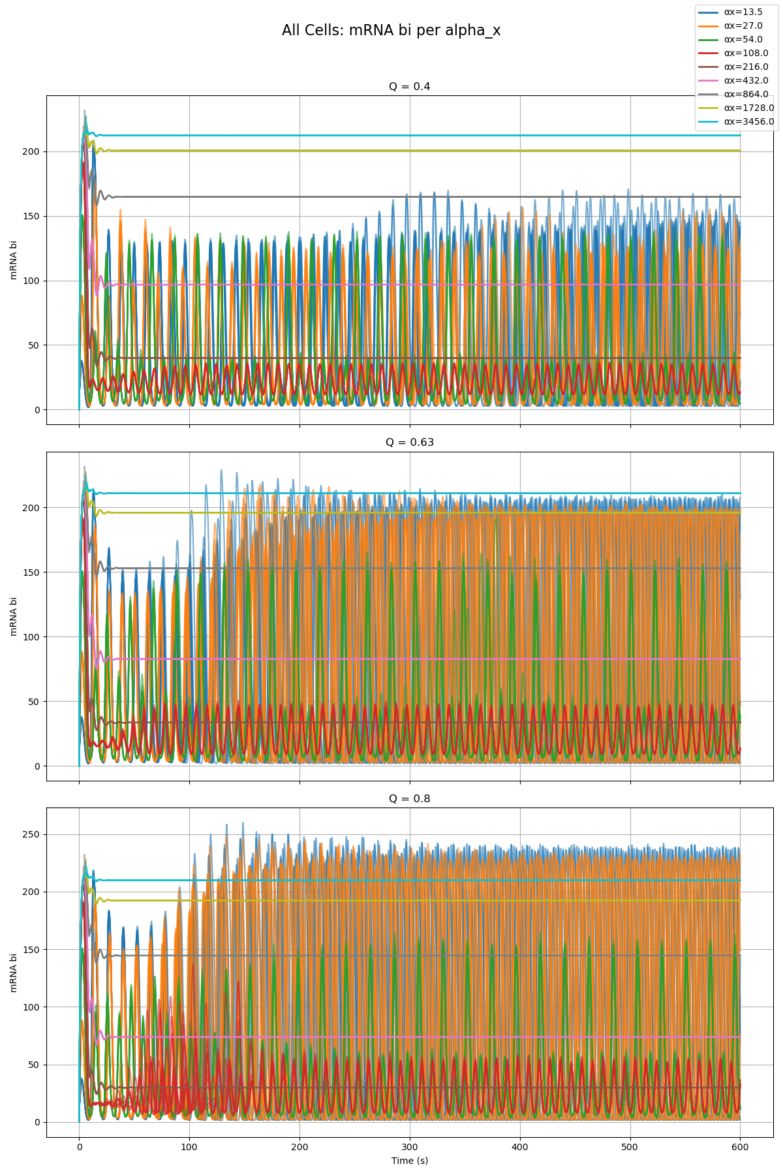
Combined Plot of All Cells and All Qs From Alpha_X Parameter Scan

Slide 8
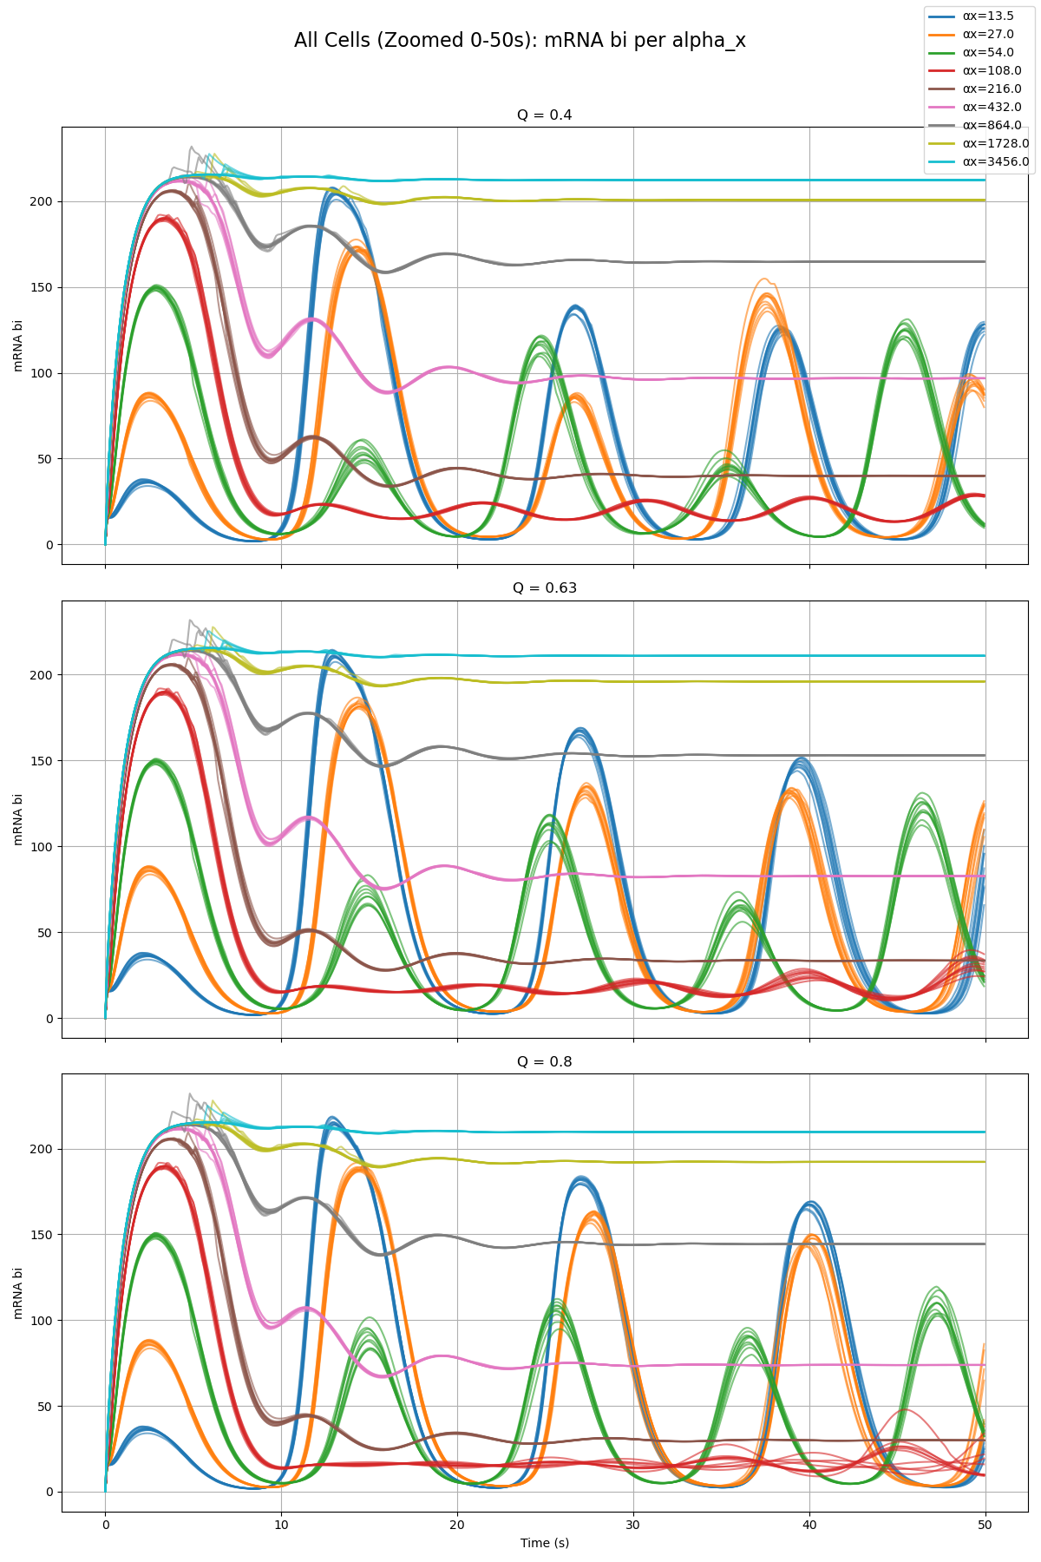
Combined Plot of All Cells and All Qs From Alpha_X Parameter Scan

Slide 9
Alpha_Y

Slide 10
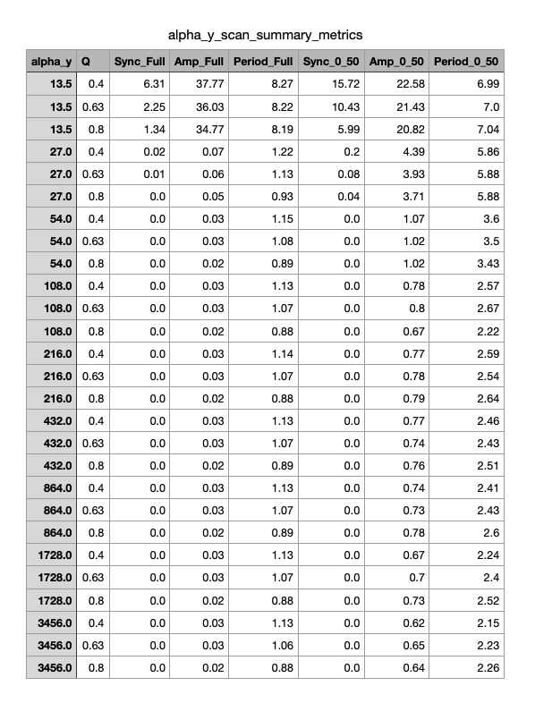
Summary Table From Alpha_Y Parameter Scan

Slide 11
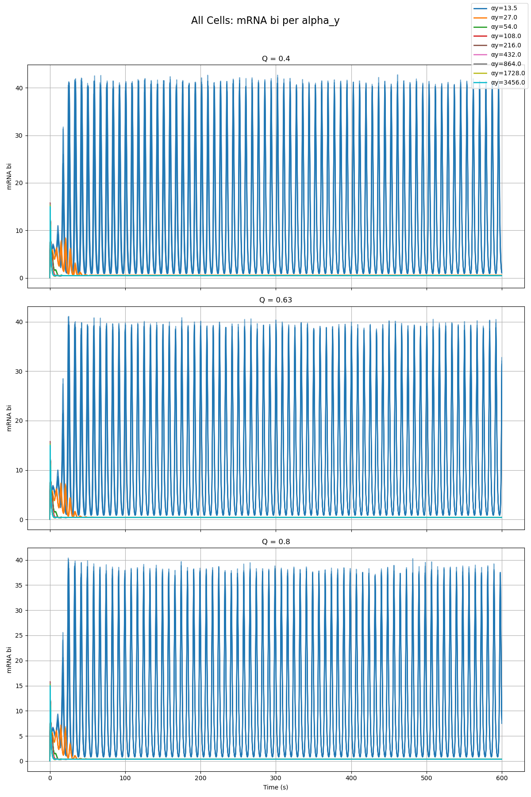
Combined Plot of All Cells and All Qs From Alpha_Y Parameter Scan

Slide 12
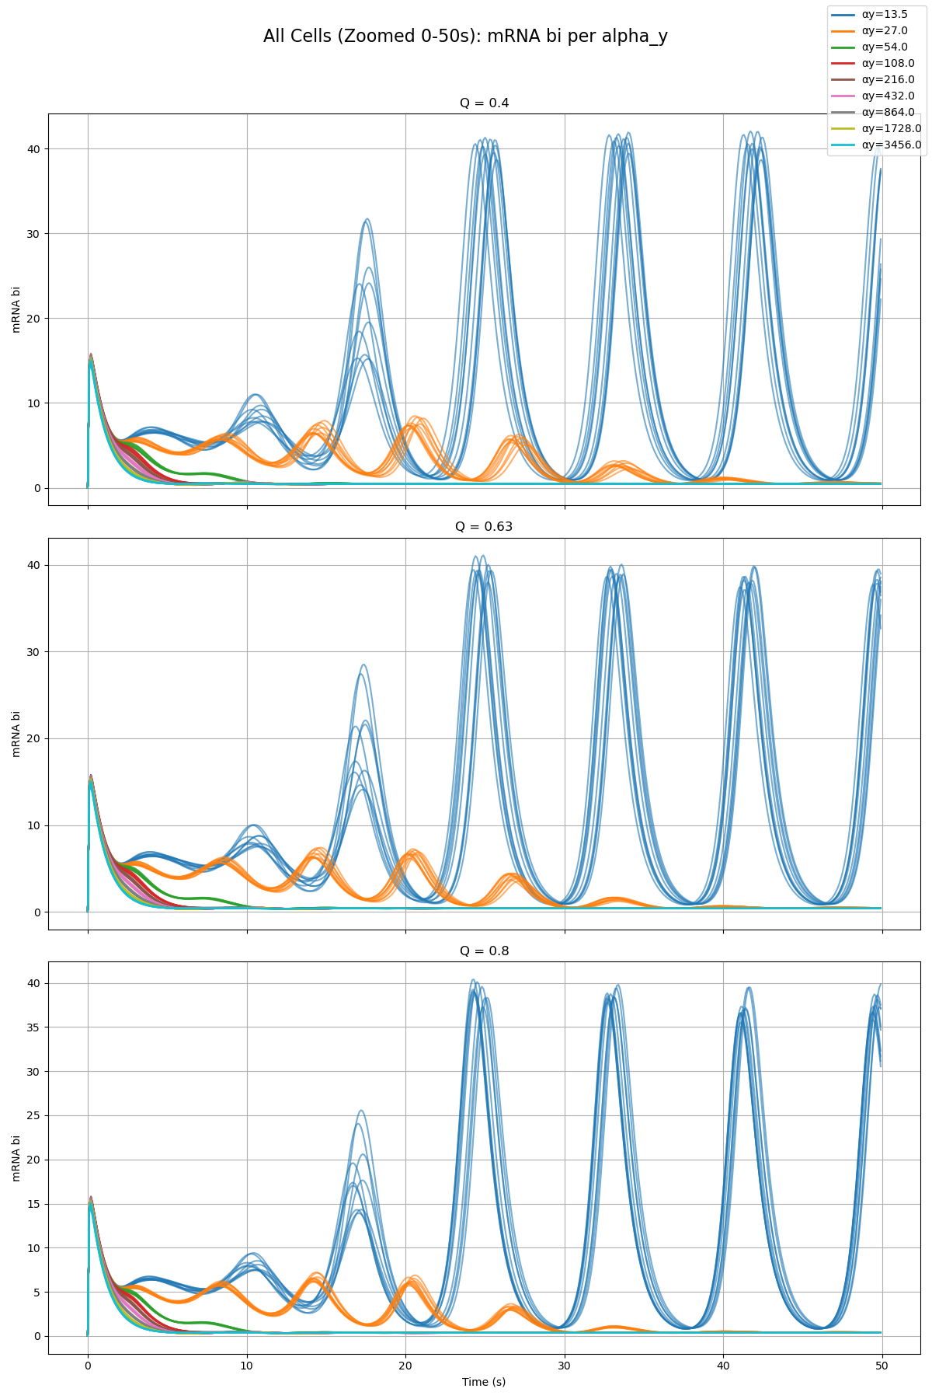
Combined Plot of All Cells and All Qs From Alpha_Y Parameter Scan

Slide 13
Alpha_Z

Slide 14
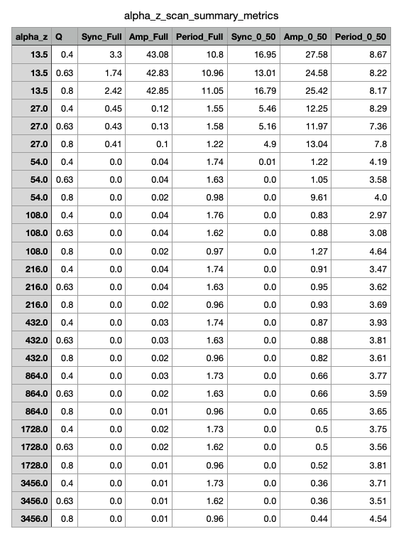
Summary Table From Alpha_Z Parameter Scan

Slide 15
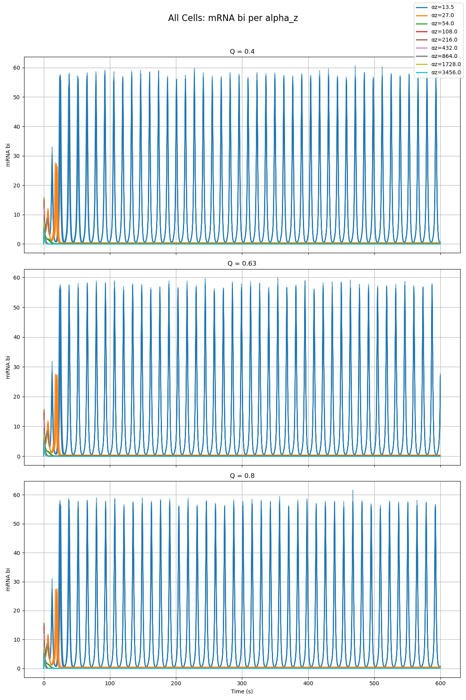
Combined Plot of All Cells and All Qs From Alpha_Z Parameter Scan

Slide 16
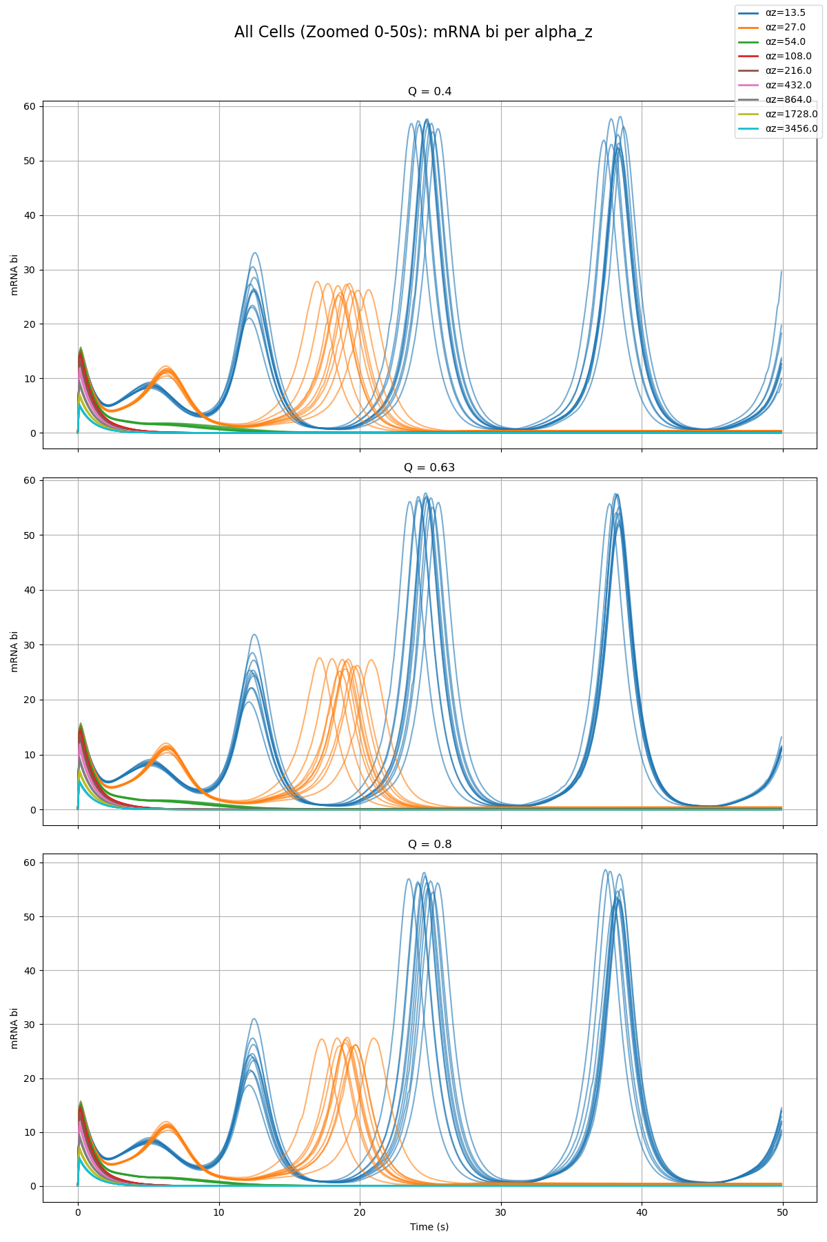
Combined Plot of All Cells and All Qs From Alpha_Z Parameter Scan

